Slide 1
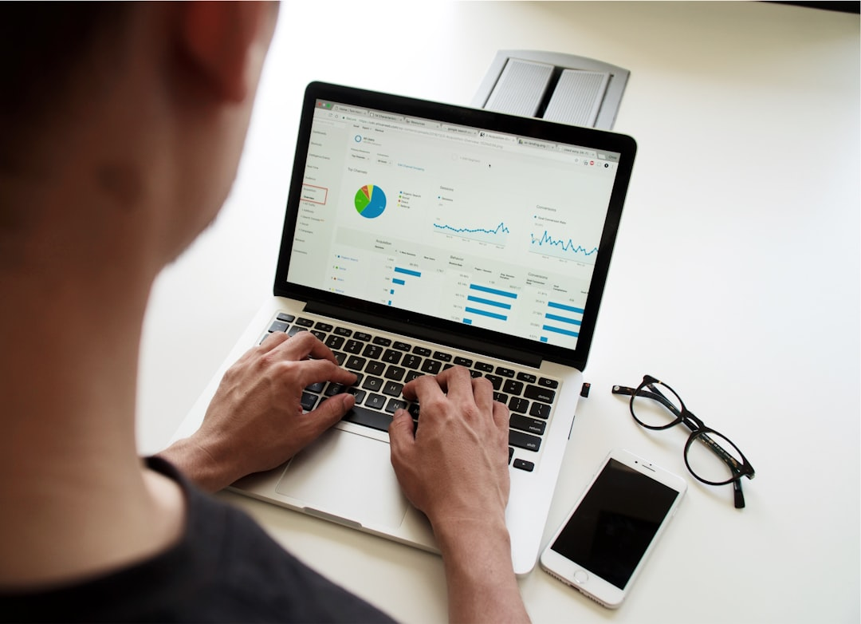
NAME
18 OCTOBER 2024
INTRODUCTION TO DATA ANALYTICS
CODE AND CREATE BOOTCAMP

Slide 2

LORRETA ANYIKA
Data Analyst with a background in Computer Science and Statistics.
Founder of ALU Datatok, a student-focused data analytics learning platform.
Experience teaching Excel, SQL, and Python to undergraduates and young professionals.
Passionate about helping enthusiasts transition into data careers
Lorreta Anyika across all socials. Let's connect!

Slide 3

INTRODUCTION TO DATA ANALYTICS
INTRODUCTION TO MICROSOFT EXCEL

Slide 4
INTRODUCTION TO DATA ANALYTICS
LEARNING OBJECTIVES FOR TODAY
01
02
03
Navigating Excel Interface
Simple Calculations and Data Preparation
MS Excel Overview

Slide 5
INTRODUCTION TO DATA ANALYTICS
MS EXCEL OVERVIEW
Expertise Check???
Beginner?
Intermediate?
Advanced?
If you are a beginner, congrats on making it here. I am happy to hold your hands

Slide 6
Widely Used – Standard tool across organizations.
Easy to Learn – User-friendly for beginners.
Data Cleaning & Analysis – Supports formulas, filters, pivot tables.
Visualization – Quick charts and graphs.
Integration – Works with other tools & databases.
Accessibility – Affordable and easily available.
INTRODUCTION TO DATA ANALYTICS
WHY MS EXCEL ?
If you are a beginner, congrats on making it here. I am happy to hold your hands

Slide 7
INTRODUCTION TO DATA ANALYTICS
SKILLS TO MASTER
Beginner:
Data Entry & Formatting
Basic Formulas (SUM, AVERAGE, IF)
Sorting & Filtering
Conditional Formatting
Basic Charts (Bar, Line, Pie)
If you are a beginner, congrats on making it here. I am happy to hold your hands

Slide 8
SKILLS TO MASTER
Intermediate
Pivot Tables & Pivot Charts
Lookup functions (VLOOKUP, HLOOKUP, XLOOKUP, INDEX-MATCH)
Data Cleaning (Remove Duplicates, Text-to-Columns, Flash Fill)
Conditional Logic (IF, Nested IF, IFS)
Basic Statistical Analysis:
Mean, Median, Mode
Standard Deviation & Variance
Correlation (using CORREL function)
INTRODUCTION TO DATA ANALYTICS
If you are a beginner, congrats on making it here. I am happy to hold your hands

Slide 9

INTRODUCTION TO DATA ANALYTICS
Q & A

Slide 10



